Slide 1
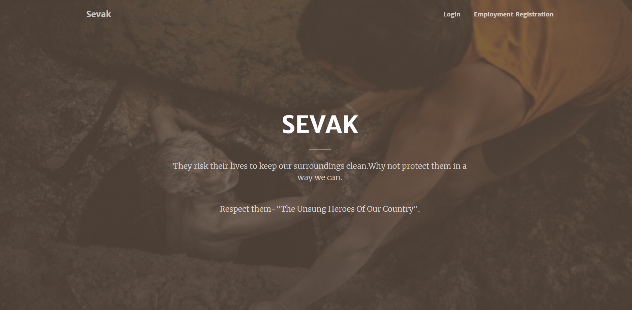

Slide 2
Qualitative impacts of Sevak

Slide 3
What are the issues to be addressed ?
It has been reported that sanitation workers in India do not use any protective equipment–boots, gloves, masks or other equipment
to clear the drains or collect the solid and liquid waste.
The health and safety of sanitation workers
is not explicitly guaranteed by a legislation such as those for
workers in plantations, factories, mines, dock and construction
sector.

Slide 4
Also, there is no legal mandate for reporting injuries,
unlike in the Factories Act. These workers are not covered by the Employees’ State Insurance Scheme to safeguard from
occupational diseases or injuries.
Thus, there are only a few instances of compensation by the employer or contractor.
This is only one of the reasons why this problem is a major concern to be addressed.

Slide 5
In order to realize the health rights of these marginalized
workers we need to include
implementation of safety practices at work,
occupational health surveillance and research, and
legislation that identifies hazardous work practices and work-related health problems as notifiable and compensable.

Slide 6
How Important is this scenario ??
Sanitation workers are the frontline health workers of our country.They succumb to the society’s so called caste system and hence are forced to remain as sanitation workers.
They come into direct contact with human waste, toxic gases and a variety of other garbage, without proper equipments and precautions and are hence exposed to a wide variety of health hazards and infections in the long run.
Despite doing such an important job, they are ostracized and sidelined by people.

Slide 7
To understand this better, let us consider the following facts ,
A study conducted by Dalberg Associates 2 in 2018, estimated 5 million sanitation workers in various urban locations across India.
Sanitation workers, especially those who work in sewers get exposed to toxic gases like carbon monoxide, methane,ammonia which cause the workers to lose consciousness or die.
Adding to this, these workers are the breadwinners of their families.
Hence these families also suffer due to such health consequences or loss of life.

Slide 8
How Sevak helps here ?
Sevak will significantly help in early identification of excess amount of toxic gases hence giving enough time for the worker to escape unscathed.
In addition it rolls out several additional features like fall detection,emergency button, heart rate and temperature monitoring, obstacle detection and most importantly location detection.
Sevak has been solely developed to prevent any accidental deaths of these brave workers.In short ,Sevak is a safety gear that protects the lives of these workers.

Slide 9
Social Impacts of Sevak
Improving the social conditions and divide in the society by helping the workers forced into this hazardous occupation .
This is done through the government and the public coming together in taking great care and effort to ensure a much safer and better working condition.
By investing in the health,sanitation,cleanliness of the country, and thus bridging the gap between the government and citizens.
The government will be making wise decisions to alleviate the grievances of a big section of the nation.

Slide 10
Impacts of Sevak on Health
The sanitation workers belong to that strata of the society who deals with unclean living conditions and lack of sufficient living space.
They are forced into slum areas which are notorious for their thickly populated one room houses and crowded streets.
A sanitation worker in such areas pose a big threat to spreading of diseases and outbreak of epidemic situations .
The proof and significance of this matter can be observed from the corona virus pandemic that we are currently facing .

Slide 11
Impacts of Sevak on Health
Sanitation workers being in close contact with dirt,garbage and waste which are breeding grounds for a variety of disease causing microbes and pathogens.
These workers find themselves at a greater risk of being attacked by infectious diseases that often leads to death .
They are also forced into acting as carriers spreading the diseases to millions of people.
Sevak to an extent helps in keeping track of their health through the heart rate and temperature monitoring. In addition it also gives an idea about the concentration of toxic gases they have been exposed too.

Slide 12
Quantitative Impacts of Sevak

Slide 13
Economic Impact of Sevak
Occupational injury and illness are matters of health, but they are also matters of economics, since they stem from work, and work is an economic activity.
Recent survey data from 500 organizations found that 73% of employers believe health and safety requirements benefit their business as a whole, while 64% reported they save money in the long term.
Hence, from the above data ,it is evident that our product being a health and safety monitoring equipment would lead to great deal of economic gain in favour of the organisations that hire sanitation workers

Slide 14
Financial losses and investments :
It is a cost effective product since the components involved in its manufacture is relatively cheap.
The investment will be of great help and use to the workers and such devices will help the drainage workers in situations were they cannot help themselves.

Slide 15
Reach of our service
There are 100,000 rural treatment plants in India and 5 million workers and Sevak can be used without any concern in these regions.
The product effectively measures the concentration of poisonous gases present in the enclosed space,the workers heart rate or whether he feels unconscious and fall which are the main reasons that causes the death of the worker.
An alert along with the location details is send to authorities, the worker is also alerted if it is a life threatening situation.
In other occasions, the worker can request for help from the authorities by pressing a button provided on the device.

Slide 16
According to Down The Drain! -A study of the occupational and health hazards and the perils of contracting faced by sewage workers in Delhi.
The study covered various issues faced by the sewer workers in Delhi, including socio-economic challenges, health and safety issues, contracting related issues and the need for change.
The report narrates, based on a 2008 database, that in Delhi alone, over 5,500 workers are deployed to put city’s sanitation in order, covering 1,50,000 manholes spread across 5,600 kms of internal, peripheral and trunk sewers .
These carry 2,871 million litres of sewage in a day. The sample survey found that 67% of these workers were from Valmiki caste. Over half of these workers engaged in such a risky work had no insurance cover, or other social protection measures.
Thus, services provided by Sevak will be of great help to these large number of workers.

Slide 17
A better Long term Investment
This device helps out the drainage workers in monitoring their environment and health and if at any point they experience a life threatening situation this device becomes useful.
Considering the large number of people who work in the drainage cleaning sector, a device which helps them be safe has a long term effect.
They can feel at ease while working in an enclosed or isolated places and such devices should be mandated by the government to keep them safe.

Slide 18
Reduced Risks of Deaths
There is always news now and then of drainage workers dying due to certain contributing factors such as poisonous gases or the worker being unconscious.
This situations can be effectively prevented by using our device in detecting the various harmful gas concentrations in his/her work environment and monitoring their health such as heart rate or
if they are working in a suffocating environment by measuring the temperature and humidity of the enclosed space.

Slide 19
According to the data collected by the Baseline survey of conservancy workers of Municipal Corporation of Greater Mumbai Tata Institute of Social Sciences ,
261 deaths on average per year among sanitation workers in this Municipal Corporation, with 31% respondents reporting ill health during the survey.
Despite this, the health of manual scavengers and sanitation workers was highly neglected, with few receiving medical compensation for occupation related health issues and accidents.
By opting to use Sevak, the above percentages will be reduced by a great number.

Slide 20
Business Analytics Opportunities
Data Mining-Since we get a plethora of sensor data through real time,this can be used to study about the environmental conditions inside and hence bring about predictions like-in which area the gases concentration is high,or which areas the blockage cannot be cleaned manually, the areas where amount of waste is higher etc.
Project Management- With the data gathered and predictions made we can allocate the resources and equipments needed accordingly.
Alerts are sent to the concerned authorities through the dashboard and mobile(as message and phone calls) immediately resulting in timely action and intervention,thus preventing loss of life.

Slide 21
We do not have reliable statistics of people who are engaged in this kind of work.
Another indirect advantage of Sevak is that the employee’s data is collected.Employee management is also a future scope of our project.
It will hence address the serious issue of tracking their work and also paying the wages on time.
This will also be beneficial when any new government welfare scheme is launched. This will assure that these benefits directly reach the deserved thereby preventing corruption by the middlemen involved.

Slide 22
The End

